Slide 1

DBMS PROJECT
NIT WARANGAL
FACULTY : DR.RAMAKRISHNUDU
DR.RBV SUBRAMANYAM
​
TEAM :
21CSB0B07 B BHARADWAJ
21CSB0B62 U ASHISH KUMAR

Slide 2
PROBLEM STATEMENT
MALL MANAGEMENT DATABASE SYSTEM
Shopping malls are fast becoming a central part of life all over the world. Many malls are being constructed in all developing countries. However, maintenance of malls is an important necessity. So, we have designed a database to store information about Mall.
Through this database system we can manage maintenance of all the shops and other places in a particular mall and also monitor all activities of all Mall. Also, it enables the administrator to get information about expenses and earnings of all the shops in a Mall which gets updated each time after installment of any new activity with less time and less effort.

Slide 3
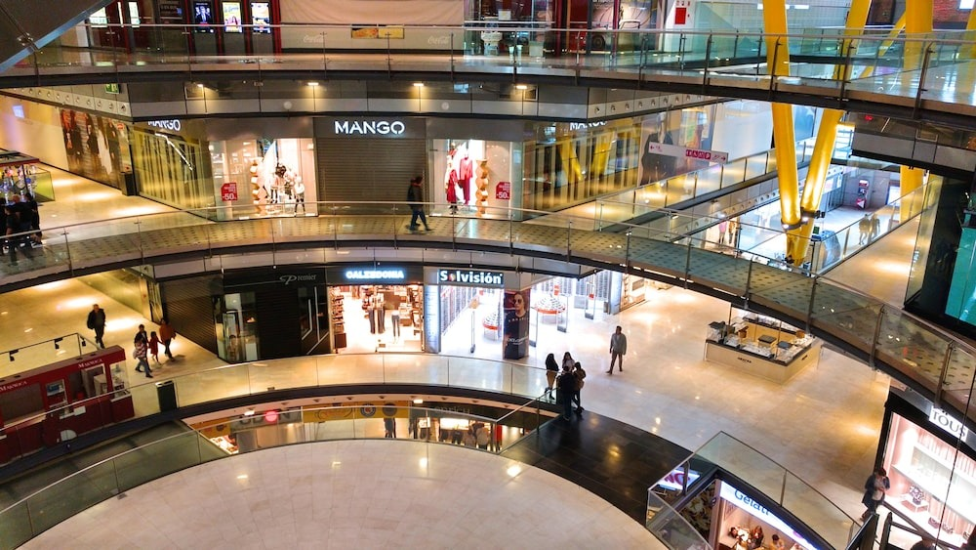
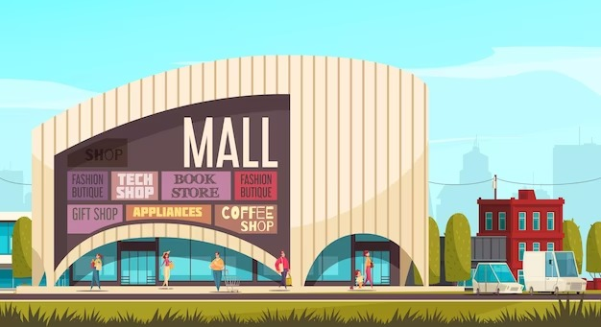

Slide 4
CONTENTS
ER Diagram
Assumptions
Normalized Tables
Relational Schema after normalization
Queries and Output

Slide 5
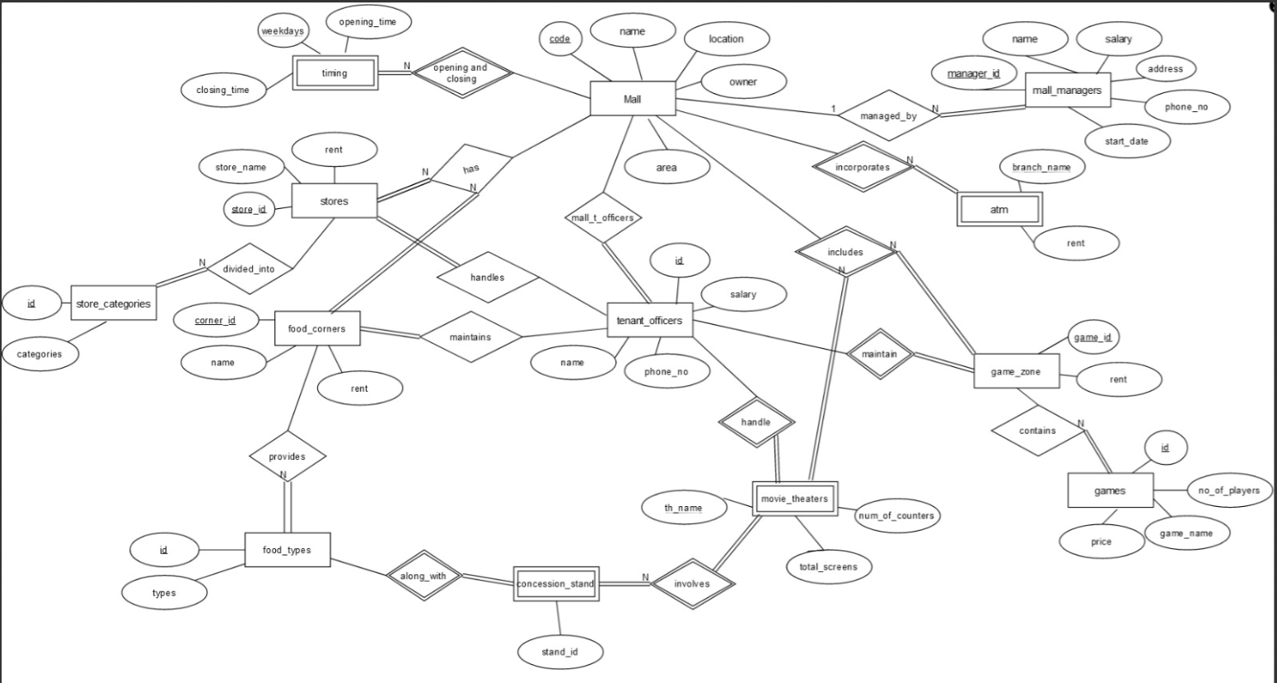
ER DIAGRAM

Slide 6
ASSUMPTIONS
1) Each mall has at least one Tenant Officer, and each tenant officer is employed in at least one of the given malls, therefore there is total participation and many to many relationship between mall and tenant_officers. Mall has area with unit sq.ft.
2) In mall managers relation, each manager is employed in at least one of the malls, So there is total participation of Mall_managers.
3) Timing relation is a weak entity set having weekdays as its partial key.

Slide 7
ASSUMPTIONS
4) Food_Types and Store_Categories & Games relations store information about the types of food corners like restaurants, ice-cream parlour etc., and clothing, pharamacy etc. and different game names respectively along with its ID to identify the type.
5) Stores and Food_Corners have different IDs(Primary key) for different malls. Also, each mall has no, one or more than one stores, and each store is present in one mall, so there is a one to many relationship with total participation of stores.Same is in the case of Food Corners relation. Rent given is per month.

Slide 8
ASSUMPTIONS
6) Game Zone is a weak entity set with GameID as its partial key, which is also a foreign key from Games table. It is assumed that No. of players in the games table are not exact, there can be less no of players. Price of games are given by per player.
7) Movie Theatres is a weak entity set with Th_name as its partial key. It is assumed that each mall has only one theatre with many screens, so the relationship is one to one type.

Slide 9
ASSUMPTIONS
8) Concession Stand is a weak entity set with standId as its primary key, and it is also connected to the food_types relation with typeID as foreign key which determines the type of stand inside movie theatres. Each theatre in a particular mall can have one or more than one stand and each stand is present in only one mall, so the relationship is one to many type.
9) ATM is a weak entity set with branch_name as its partial key. Each mall has more than one ATM, so it is one to many relationship type.

Slide 10
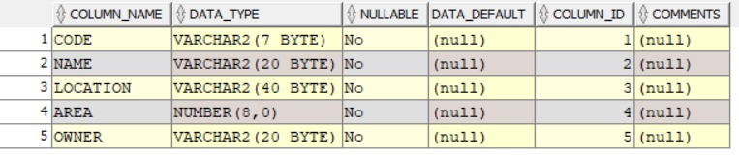
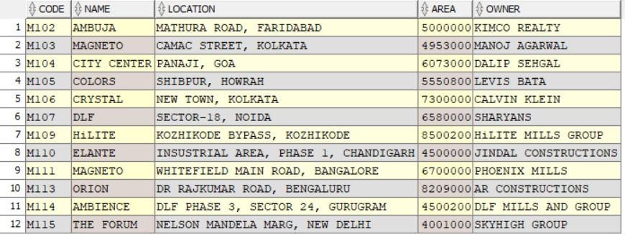
NORMALISED TABLES
1)Mall

Slide 11
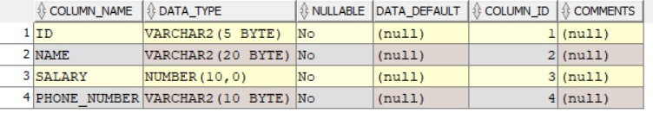
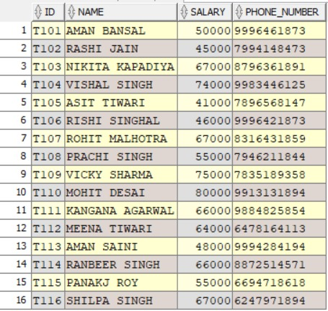
NORMALISED TABLES
2)Tenent_officers

Slide 12
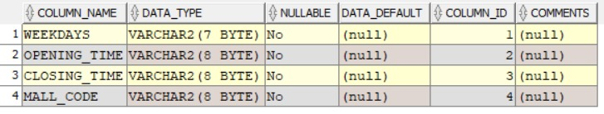
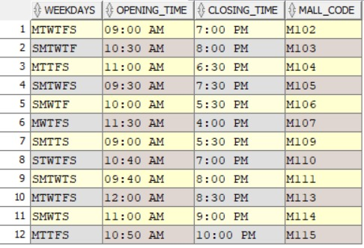
NORMALISED TABLES
3)Timings

Slide 13

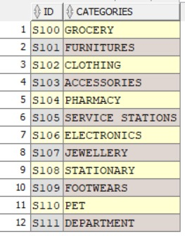
NORMALISED TABLES
4)Store_categories

Slide 14

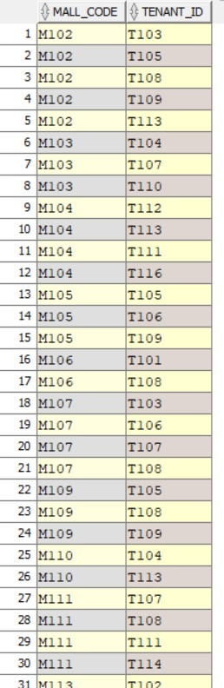
NORMALISED TABLES
5)Mall_tenant_officers

Slide 15
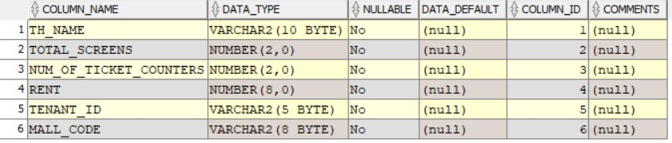
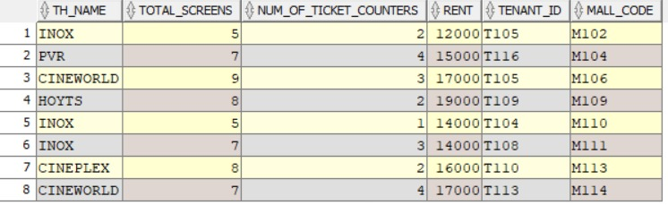
NORMALISED TABLES
6)Movie_theatres

Slide 16
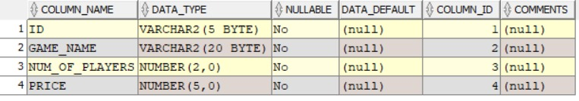
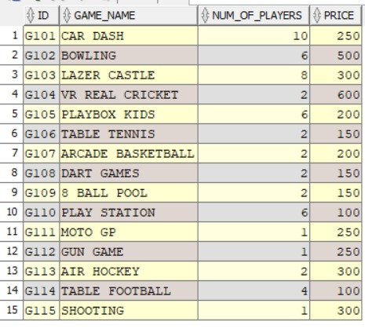
NORMALISED TABLES
7)Games

Slide 17
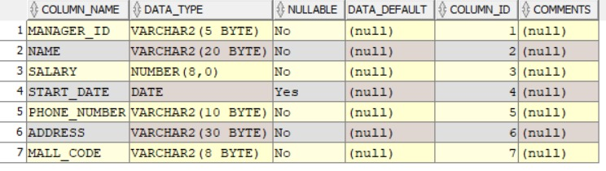
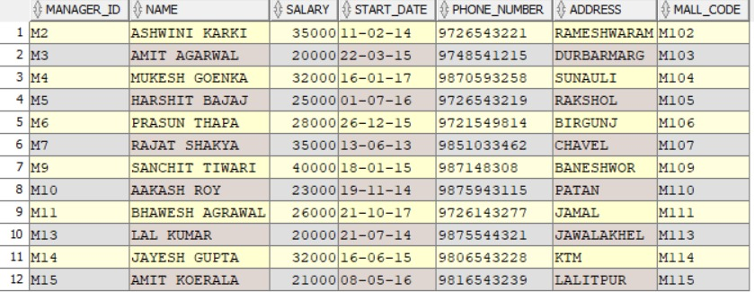
NORMALISED TABLES
8)Mall_managers

Slide 18
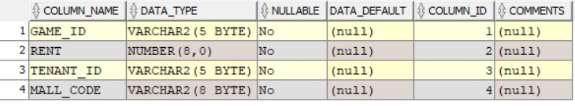
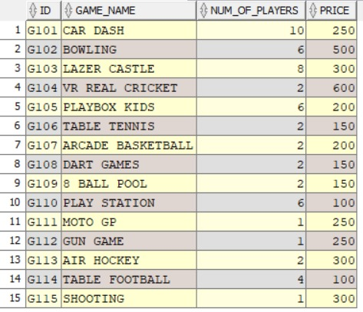
NORMALISED TABLES
9)Game_zone

Slide 19
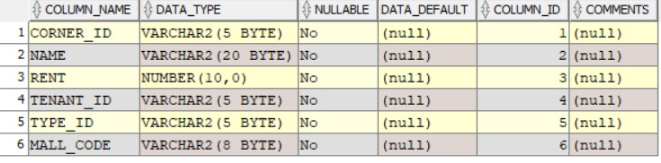
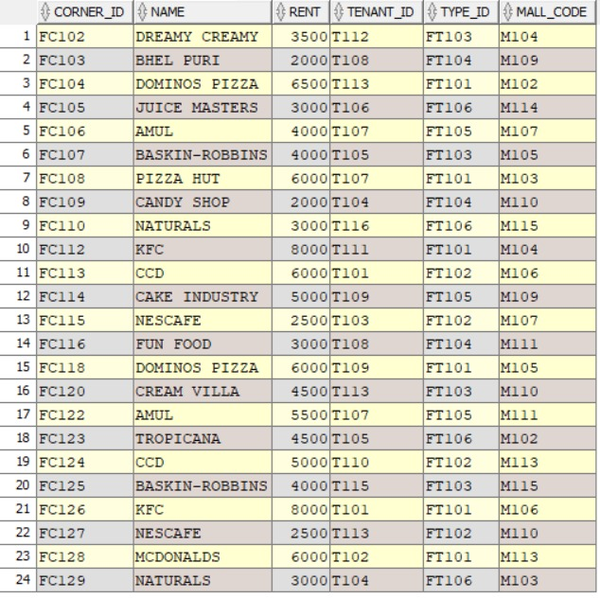
NORMALISED TABLES
10)Food_corners

Slide 20

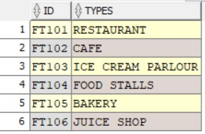
NORMALISED TABLES
11)Food_types

Slide 21
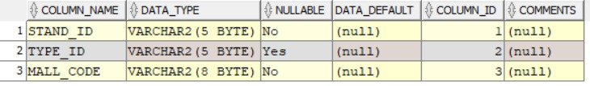
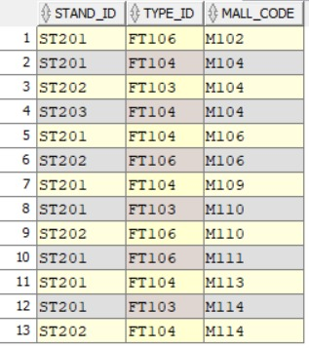
NORMALISED TABLES
12)Concession_stand

Slide 22
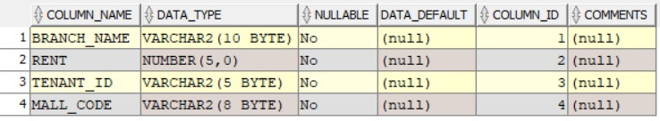
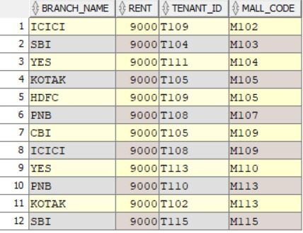
NORMALISED TABLES
13)ATM

Slide 23
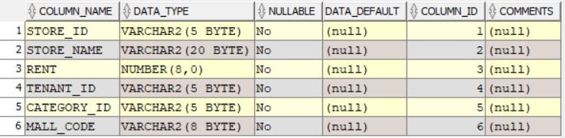
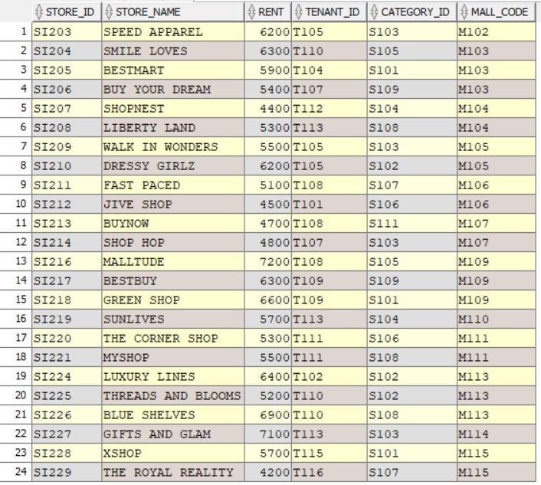
NORMALISED TABLES
14)Stores

Slide 24
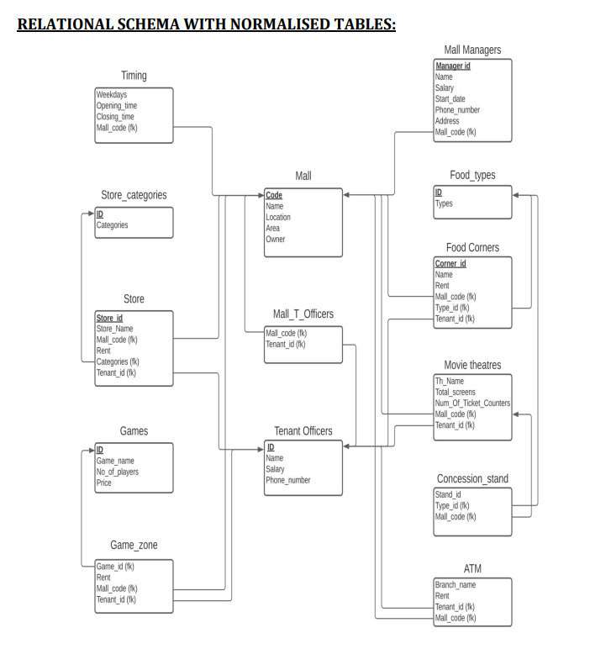
RELATIONAL SCHEMA AFTER NORMALISATION

Slide 25
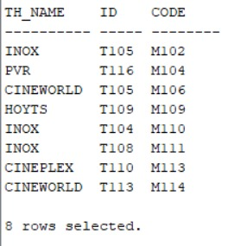
QUERIES
1)Retrieve the details of movie theaters along with their associated tenant officers and mall details
Query:
SELECT MT., TO.*, M.FROM MOVIE_THEATRES MTJOIN TENANT_OFFICERS TO ON MT.TENANT_ID = TO.IDJOIN MALL M ON MT.MALL_CODE = M.CODE;

Slide 26
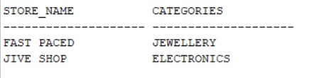
QUERIES
2)Retrieve the details of all stores in a specific mall along with their corresponding category
Query:
SELECT S.store_name, SC.CATEGORIESFROM STORES SJOIN STORE_CATEGORIES SC ON S.CATEGORY_ID = SC.IDWHERE S.MALL_CODE = 'M106’;

Slide 27
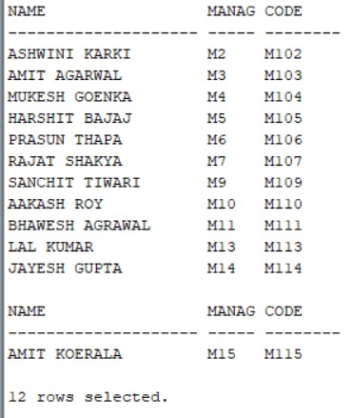
QUERIES
3)Retrieve the details of all mall managers along with their corresponding mall details
Query:
SELECT MM."NAME",MM.MANAGER_ID, M.CODEFROM MALL_MANAGERS MMJOIN MALL M ON MM.MALL_CODE = M.CODE;

Slide 28
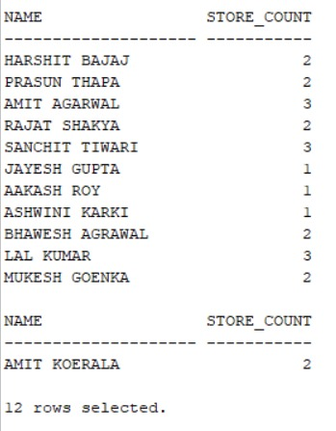
QUERIES
4)Retrieve the names of all mall managers along with the count of stores they manage
Query:
SELECT MM.NAME, COUNT(S.STORE_ID) AS STORE_COUNTFROM MALL_MANAGERS MMLEFT JOIN MALL M ON MM.MALL_CODE = M.CODELEFT JOIN STORES S ON M.CODE = S.MALL_CODEGROUP BY MM.NAME;

Slide 29
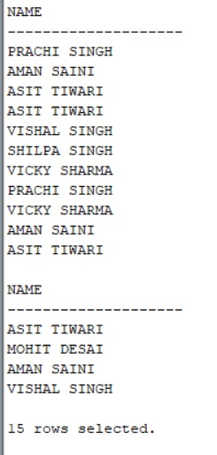
QUERIES
5)Retrieve the names of tenant officers who work in both food corners and movie theaters
Query:
SELECT TOF."NAME"FROM TENANT_OFFICERS TOFJOIN FOOD_CORNERS FC ON TOF."ID" = FC.TENANT_IDJOIN MOVIE_THEATRES MT ON TOF."ID" = MT.TENANT_ID;

Slide 30
Summary
This project involves defining primary & foreign keys, establishing relationships between entities and enforcing constraints. It also includes complex queries containing advanced SQL operations such as aggregators, sub-queries, and joins of different kinds. This queries can be used to obtain many more details regarding the malls. It can effectively manage the various entities, relationships and operations within a mall environment. It provides a solid foundation for storing, organizing and retrieving data related to malls.

Slide 31
Thank you
21CSB0B07 B BHARADWAJ
21CSB0B62 U ASHISH KUMAR

